Slide 1
COVID PATIENT HEALTH MONITORING SYSTEM (CPHMS)
Instrumentasi
Notes:
© Copyright PresentationGO.com – The free PowerPoint and Google Slides template library

Slide 2
Anggota :
Mukhammad Fahlevi Ali Rafsanjani
Richard Bina Jadi Simanjuntak
Sang Ayu Ketut Devi Saraswati
Notes:
© Copyright PresentationGO.com – The free PowerPoint and Google Slides template library

Slide 3
Color Theme
Mengapa Memilih Project ini ?
Typography
Calibri
Calibri Light
Notes:
© Copyright PresentationGO.com – The free PowerPoint and Google Slides template library

Slide 4
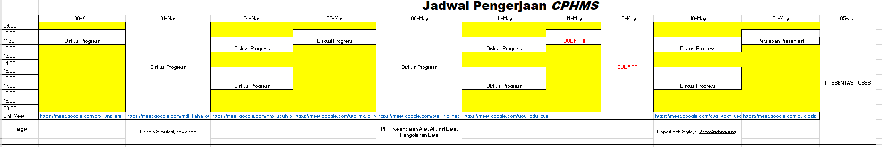
Timeline & Milestone
Presentasi Tubes
27 April – 21 Mei
Pengerjaan Tubes
24 April
Presentasi Judul
& Judul Fix
19 – 21 April
18 April
Notes:
© Copyright PresentationGO.com – The free PowerPoint and Google Slides template library

Slide 5


Timeline & Milestone
Software yang digunakan
Proteus
Arduino IDE
Notes:
© Copyright PresentationGO.com – The free PowerPoint and Google Slides template library

Slide 6
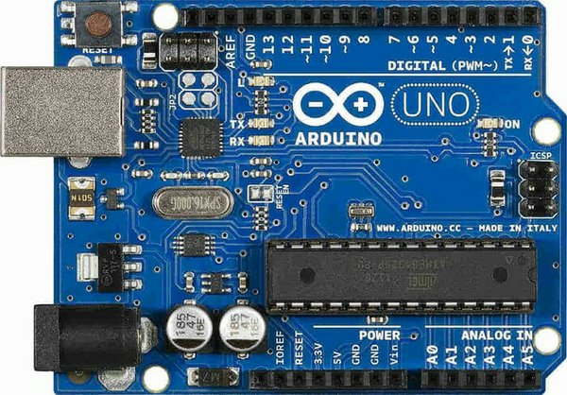

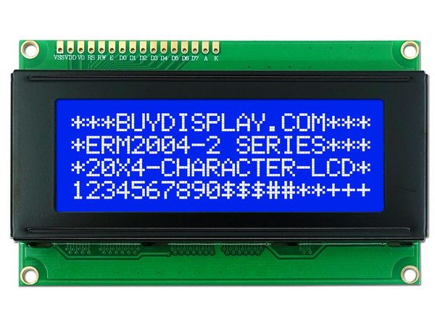
Alat yang digunakan
Arduino Uno
Button
LCD 40x2 / LM044L
Notes:
© Copyright PresentationGO.com – The free PowerPoint and Google Slides template library

Slide 7
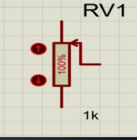
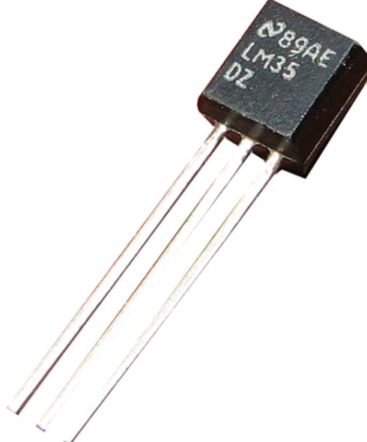

Alat
yang digunakan
Button
Sensor Detak Jantung
Potensiometer/ POT-HG
Sensor LM35
Jumper
Notes:
© Copyright PresentationGO.com – The free PowerPoint and Google Slides template library

Slide 8
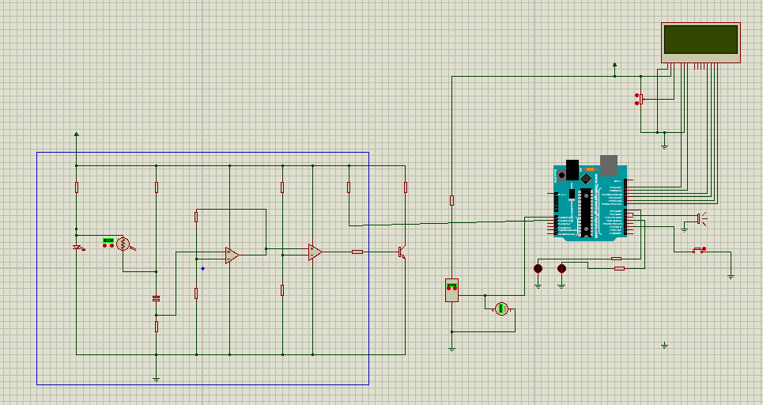
Rangkaian
Button
Notes:
© Copyright PresentationGO.com – The free PowerPoint and Google Slides template library

Slide 9
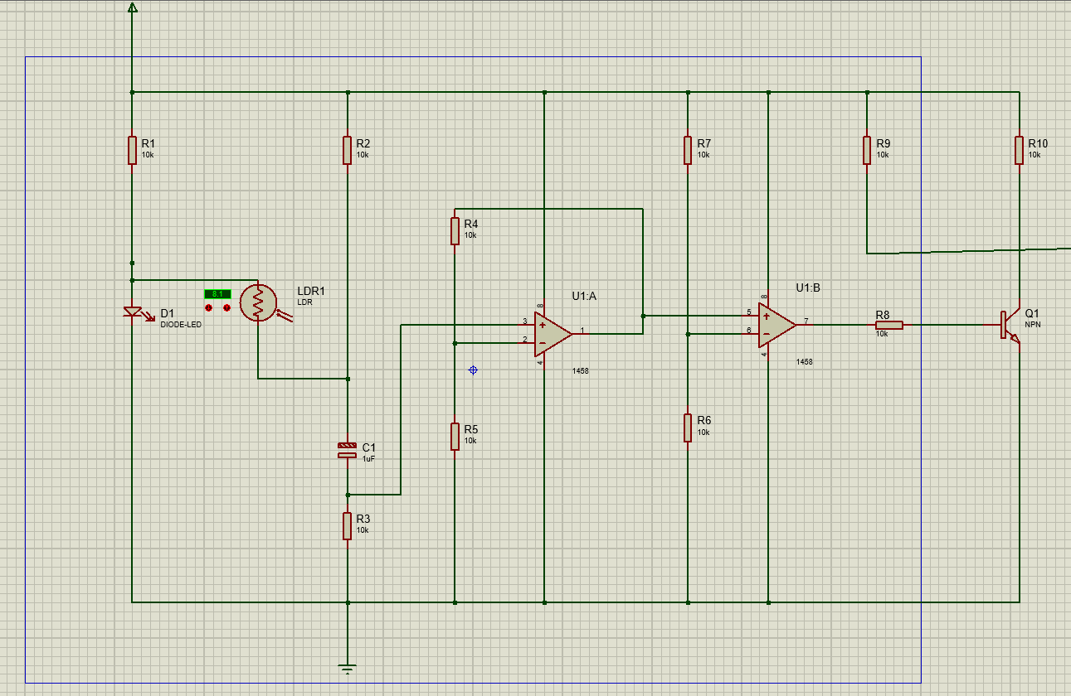
Rangkaian Pengukur Denyut Jantung
Button
Notes:
© Copyright PresentationGO.com – The free PowerPoint and Google Slides template library

Slide 10
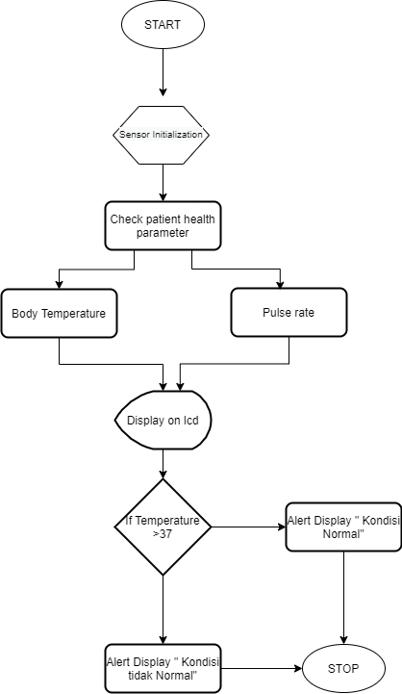
Flowchart
Button
Notes:
© Copyright PresentationGO.com – The free PowerPoint and Google Slides template library

Slide 11
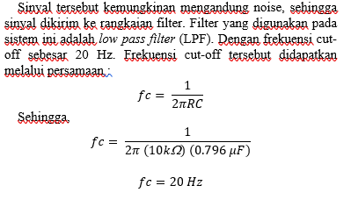
Hasil
No
1 | 10 | 101
2 | 15 | 151
3 | 20 | 202
4 | 21 | 212
5 | 30 | 302
6 | 31 | 312
7 | 32 | 322
8 | 35 | 352
9 | 36 | 362
10 | 37 | 372
Button
Pengujian Temperature Sensor (LM35)
Perhitungan Frekuensi Cut-off Pengukur denyut Jantung
Notes:
© Copyright PresentationGO.com – The free PowerPoint and Google Slides template library

Slide 12
Thank You!
Notes:
© Copyright PresentationGO.com – The free PowerPoint and Google Slides template library

